Slide 1
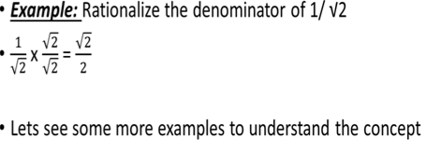
DATE: 1.04.2020
MATHEMATICS CONTENT – 5
CLASS IX
RATIONALISATION
If the denominator of a number is irrational, then the process of converting its denominator to a rational number by multiplying its numerator and denominator by a suitable number, is called Rationalisation. Such a number is called Rationalising Factor.
Here Rationalising Factor Is √2

Slide 2
Here Rationalising Factor is 2-√3
Here Rationalising Factor is √3+√5
Now do Ex 1.5 Q5 in your notebook.

Slide 3
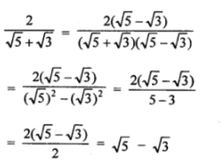
NOTES:- EXTRA QUESTIONS
Type1:-
Simplify:-

Slide 4
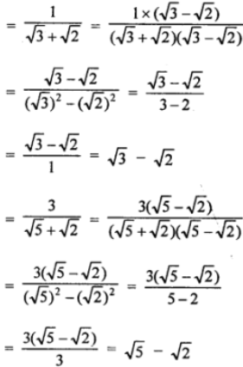
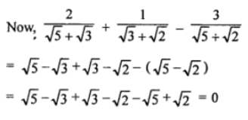

Slide 5
Type2:- Simplify each of the following by
rationalising the denominator-
1.

Slide 6
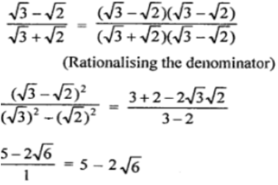
2.
3.

Slide 7
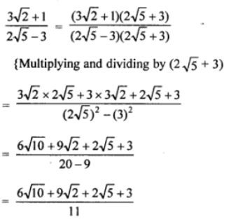
4.

Slide 8
5.

Slide 9
6.

Slide 10
7.

Slide 11
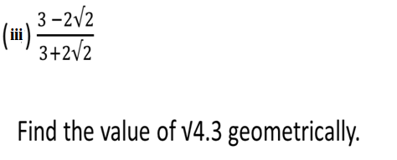
PRACTICE QUESTIONS 1- TO BE DONE IN THE NOTEBOOK.
1.
2.

Slide 12
Type3:- If both a and b are rational numbers,
find the values of a and b in each of the following-
1.
After rationalising ,we get
(See slide 5)
2.

Slide 13
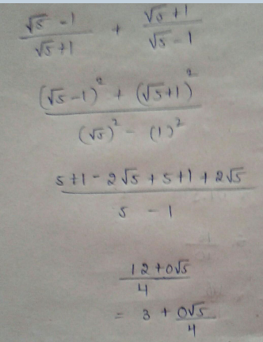
3.
…..eqn 1
Simplify
……….eqn 2
On comparing eqn 1 and eqn 2, we get
a = 3 and b = 0/4 or 0
VIDEO LINK: https://youtu.be/50YKvi5Jrto

Slide 14
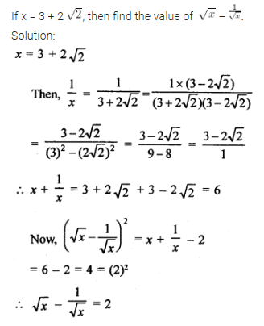
Type4:-
1.
VIDEO LINK:- https://youtu.be/ldi9R-LtC0M

Slide 15
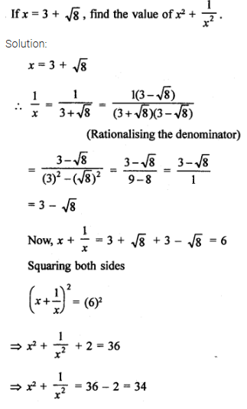
2.

